Slide 1
ONLINE BOOK STORE
By
Jaswanth-28
Abhiram-45
Manisha-65
Jayadeep-02

Slide 2
PROBLEM STATEMENT
Creating an online bookstore which provides fast and efficient access by containing variety of books from different genre

Slide 3
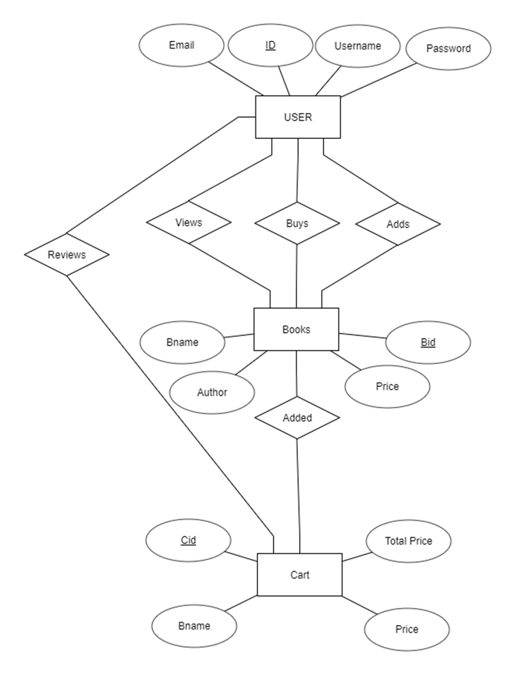
e-r diagram
The E-R diagram consists of different relationships between different entities and their attributes
The entities in E-R diagram are:
User
Books
Cart

Slide 4
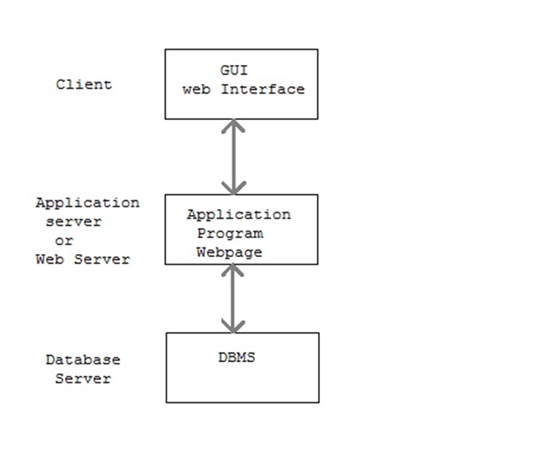
SYSTEM MODEL
This uses three tier architecture with front end using HTML,back end using MYSQL and connectivity is done through PHP.
The interface is designed through HTML,application program and database connectivity is done through PHP and the databases created and maintained by using MYSQL

Slide 5
Database connectivity
The database connection is done through PHP
PHP connects the main application program,user interface to the backend database that is MYSQL
The code written in PHP to establish database connectivity is as follows:

Slide 6
Database connectivity code:
<?php
// Enter your Host, username, password, database below.
// No password set for localhost
$con = mysqli_connect("localhost","root","","register");
// Check connection
if (mysqli_connect_errno())
{
echo "Failed to connect to MySQL: " . mysqli_connect_error(); //display error message
}
?>

Slide 7
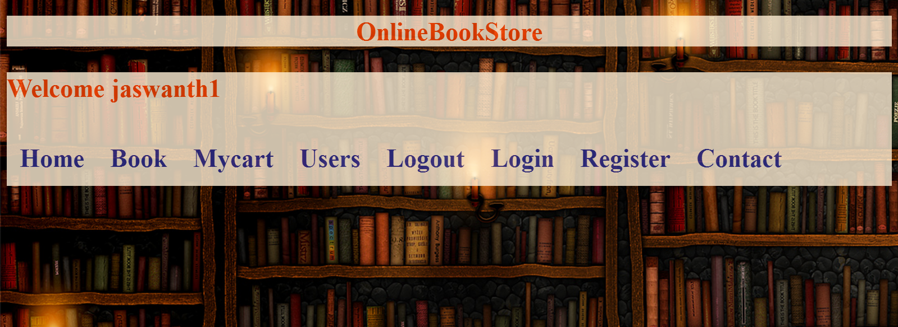

Slide 8


Slide 9
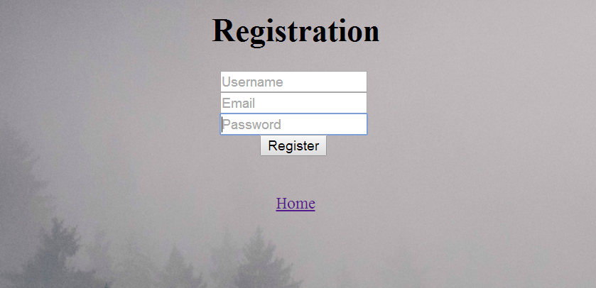

Slide 10
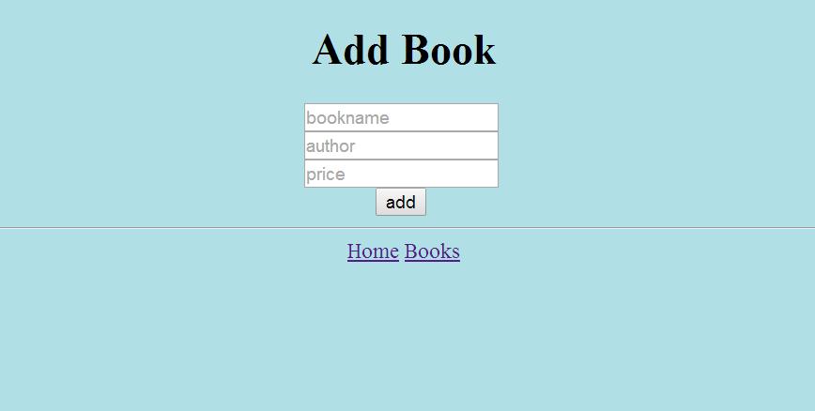

Slide 11
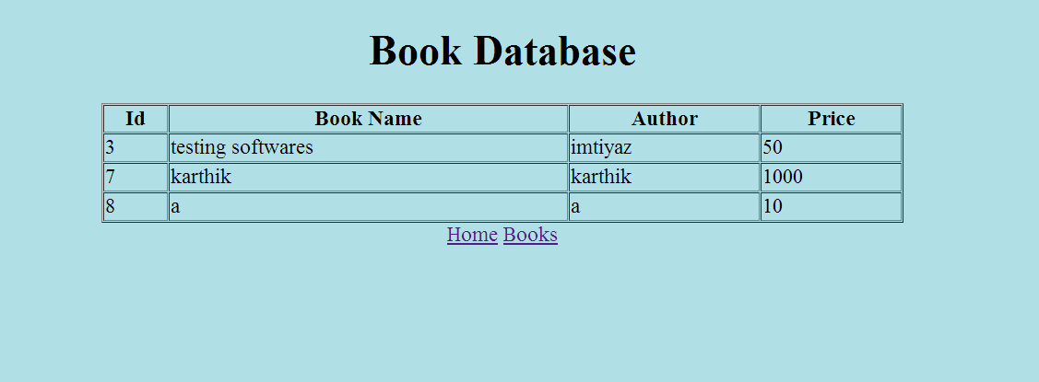

Slide 12
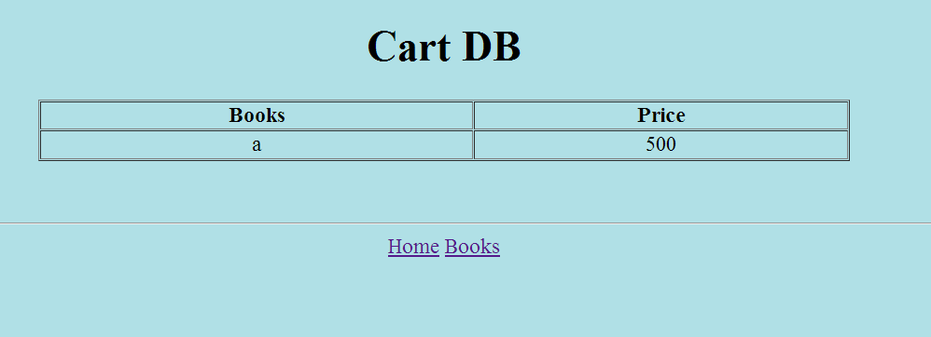

Slide 13
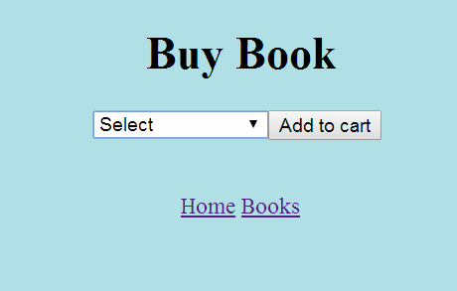

Slide 14
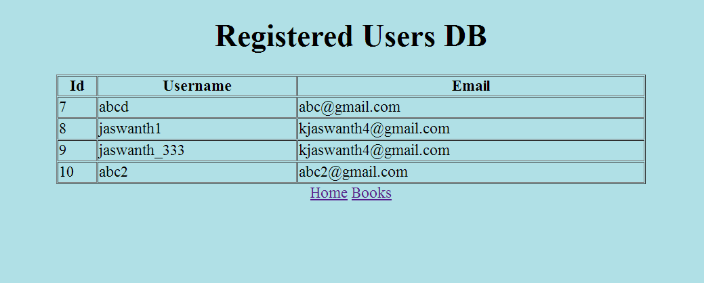

Slide 15
Thank you!

